Slide 1

Used Cars Market Analysis: Craigslist USA
Data-1202-01 Final Project Presentation
Submitted by: Group 5
Submitted to: Prof. Thomas
Group Members
Yahya Mubeen Kidwai
Gokul Gangadharan
Mandeep Kaur
Nisha Singh
Mohammed Masiuddin
Parth Bhatia
Vinod Kumar
Shahabuddin Syed

Slide 2

Table of Contents
Introduction to Dataset
Objectives of the Analysis
Cleaning Using Python
Insights from the Data
Market-share & Used Cars Demographics
Frequency of Price Distribution of Used Cars
Influence of Make Year on Price
Effect of Car Condition over Pricing
Findings & Conclusion

Slide 3
Introduction to the Dataset
Dataset: Used Cars Dataset retrieved from Kaggle.com
The dataset Provides listings of used cars posted on Craigslist within the US in the year 2021
The Dataset gives us information on the dynamics of used car market in the US.
It includes raw data like make, model, year, selling price, kilometers driven, fuel type, transmission, mileage, engine specifications, location information etc.
We will use this dataset to identify trends and patterns in pricing, demand, and other factors affecting the sales price of used cars.
We will also handles the missing values and outliers present in the dataset.

Slide 4
Objective of Analysis
Market Understanding: Gaining a understanding of the dynamics of the used car market in the US.
This includes identifying the used car density based on locations, make and models and to explore any trends, patterns, and factors influencing the used car pricing.
Price Optimization: Assisting dealerships and sellers in optimizing their pricing strategies for used cars based on different variables available.
By analyzing historical data, sellers can better identify market value and set competitive prices to attract potential buyers.

Slide 5

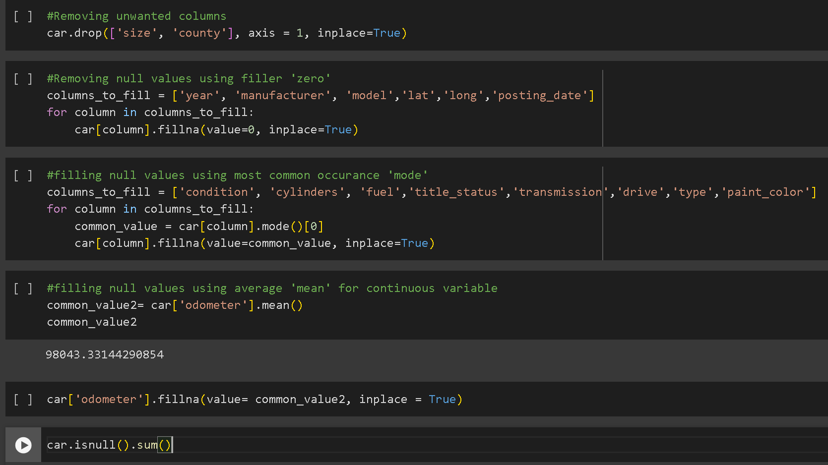
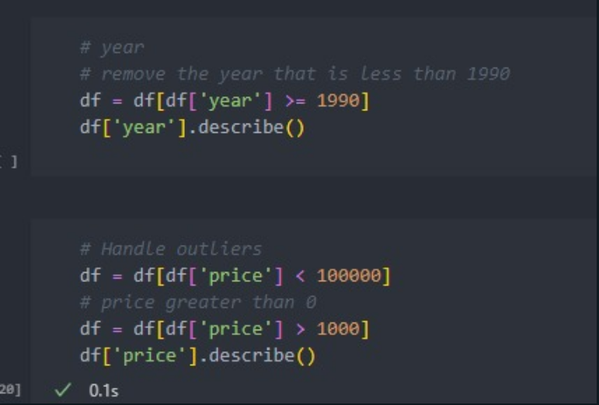
Cleaning using Python

Slide 6
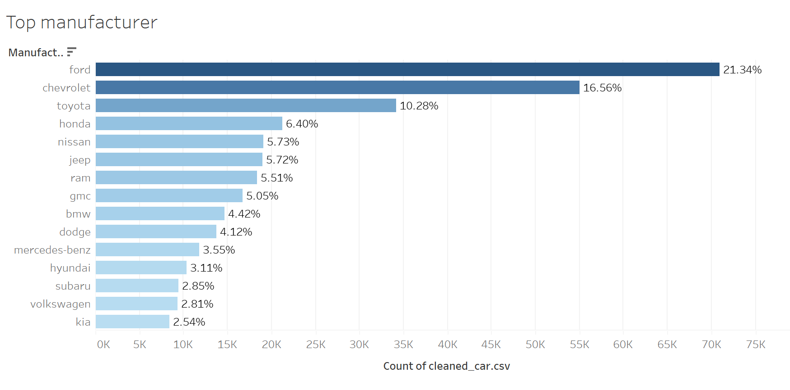
Insights from the Data: Manufacturer Market Share

Slide 7
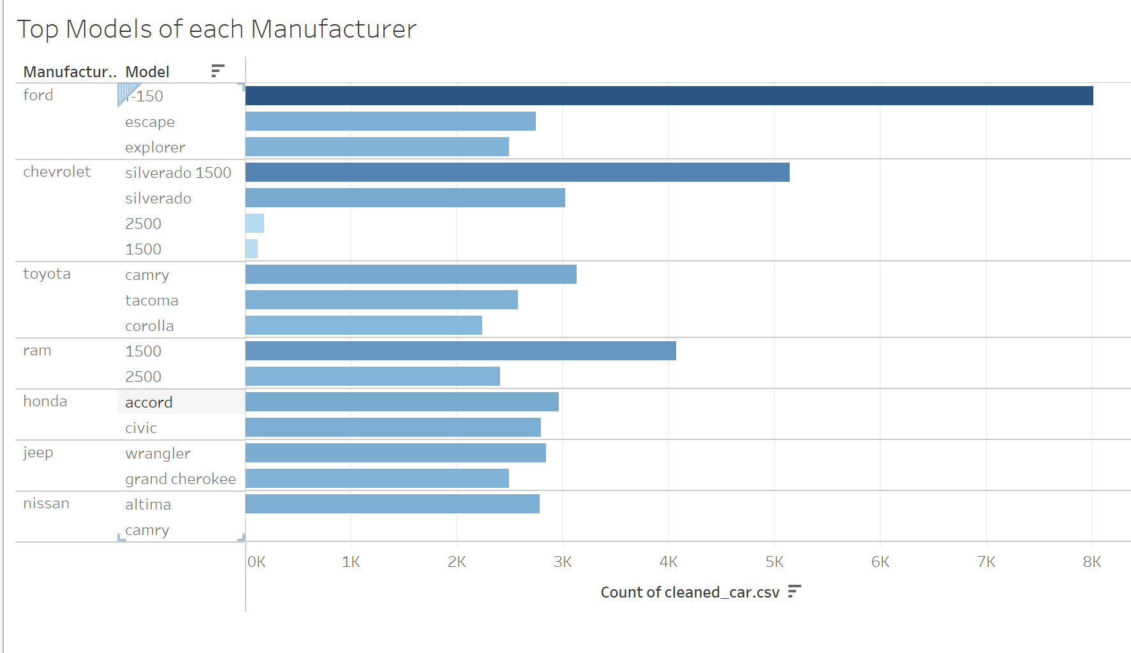
Top Listed Models from Top Selling Manufacturers

Slide 8
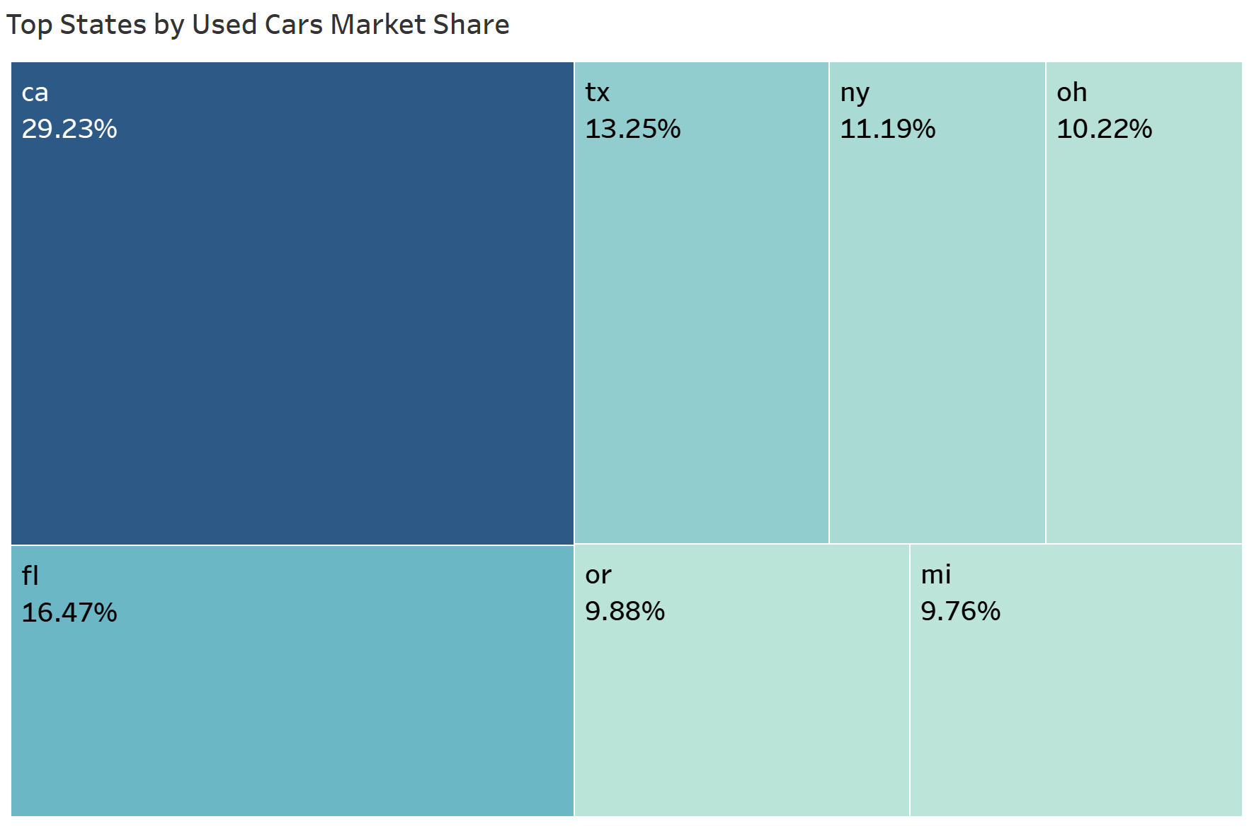
Biggest Used Car Markets in the US
California
Texas
New York
Ohio
Florida
Oregon
Michigan

Slide 9
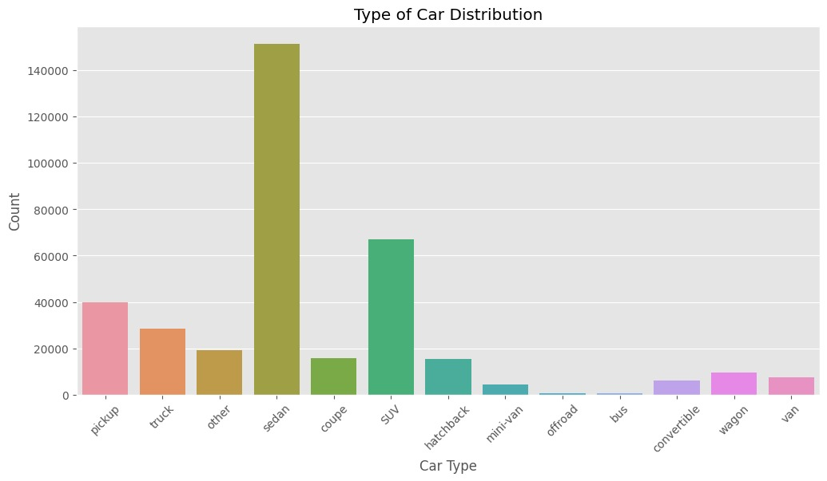
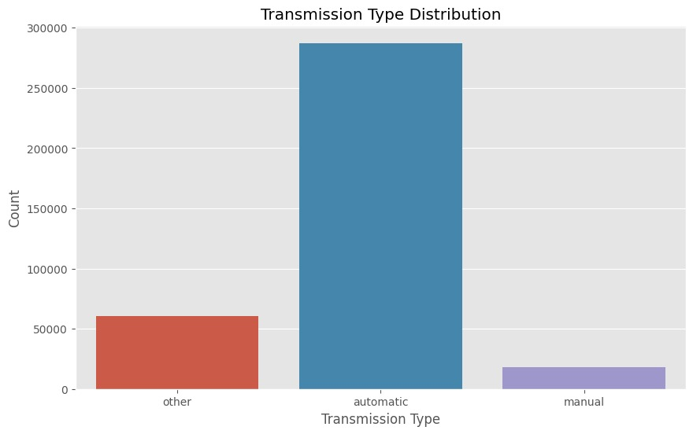
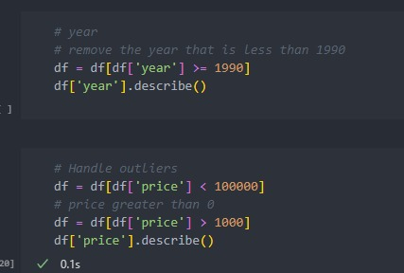
Distribution of Cars & Transmission Type

Slide 10
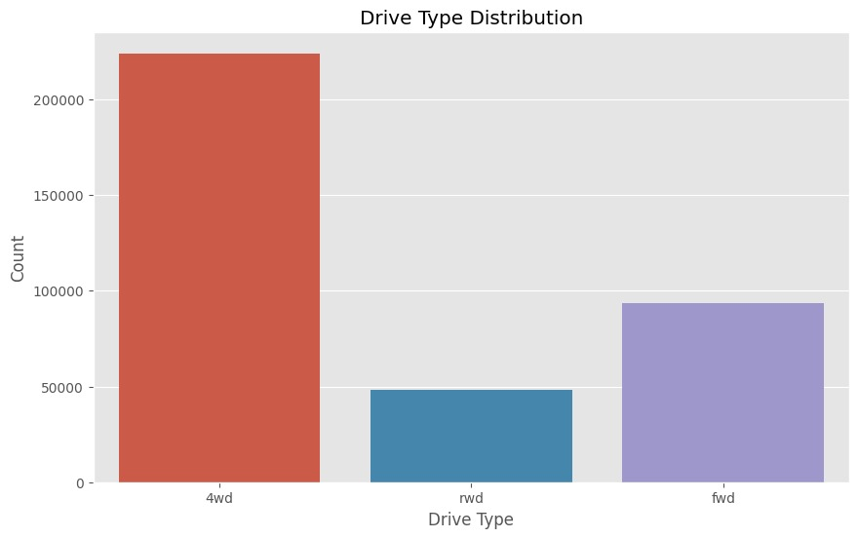
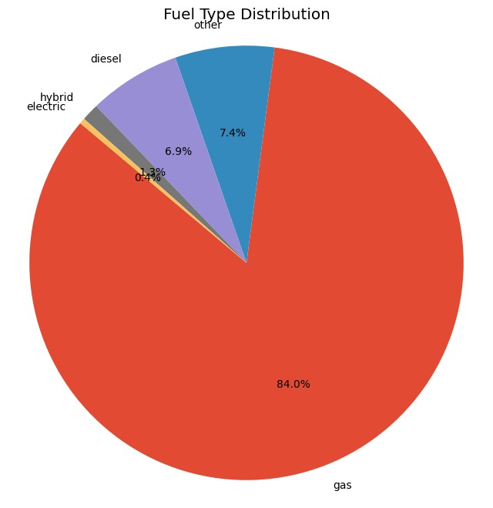
Drive Type and Fuel Type of Cars

Slide 11
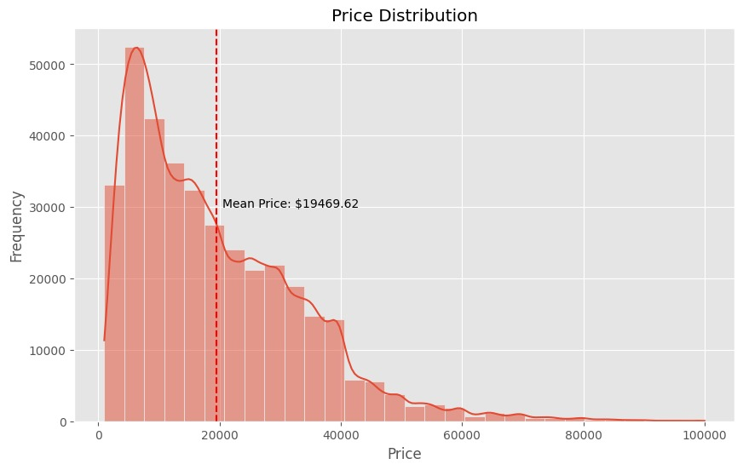
Frequency of Price Distribution of Used Cars

Slide 12
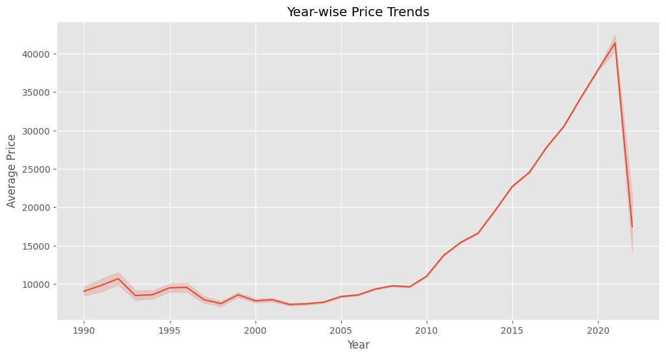
Influence of Make Year on Price

Slide 13
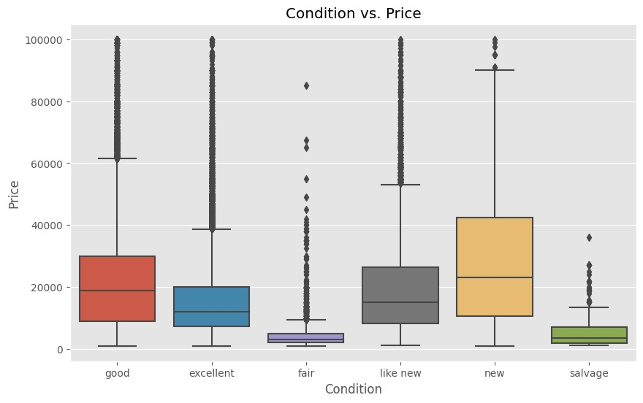
Effect of Car Condition over Pricing

Slide 14
Findings & Conclusion
Ford has highest market-share with its F150 Raptor being the top listed used car in the US
California accounts for 30% of total used cars postings
Most cars listed are Sedans with Automatic transmission, running on gas
Most of the used cars are Priced between 4000 to 40,000 USD (mean being closed to 20,000)
Factors influencing used car pricing: Make Year & Condition
The Make Year of the car has a significant impact over pricing: The newer the cars, the higher the listing price.
Condition influences price greatly: New or Good Condition cars are priced much higher than the rest.

Slide 15
Thank You

